Slide 1

GIT Introduction
A starter to GIT

Slide 2

Agenda
Overview
Getting Repository
Making Changes
Committing Changes
Git Branching
Merging, Rebase – Resolving Conflicts

Slide 3

Overview
Git (/ɡɪt/)^{[7]} is a distributed version-control system for tracking changes in source code during software development.
-Wikipedia
Big Picture
Git repository
Git Bash
Git Clients – GitHub windows
Git’s installation
Repository Managers : GitLab and GitHub
For us
Dev Azure Git
Visual Studios

Slide 4
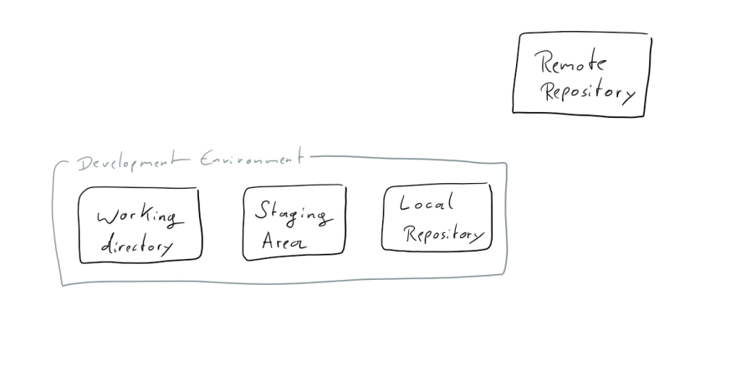
Basics – Overview of developer’s environment

Slide 5
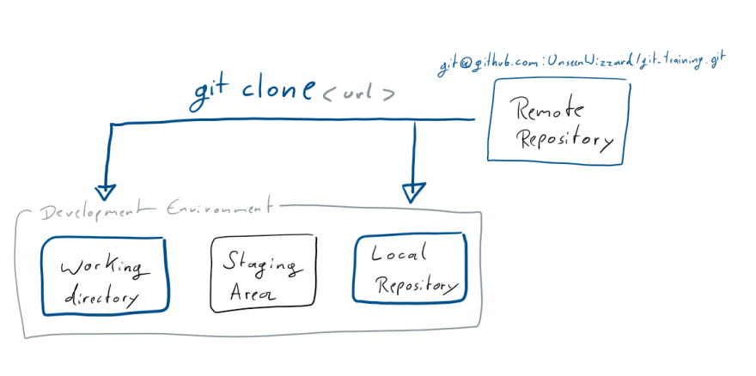
Basics - Getting a Remote Repository
Getting a Remote Repository
git clone https://github.com/{YOUR USERNAME}/git_training.git
git clone https://github.com/KedarPingle/finlearn_gitTraining.git

Slide 6
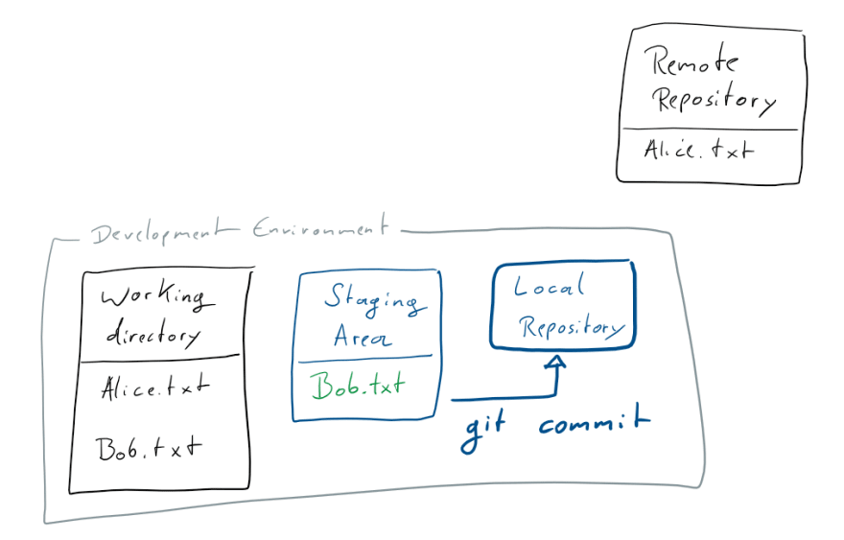
Add new files
Working Directory: tracked files that git knows about and untracked files
git status git add Bob.txt
git commit git commit -m "Add Bob"
git push

Slide 7
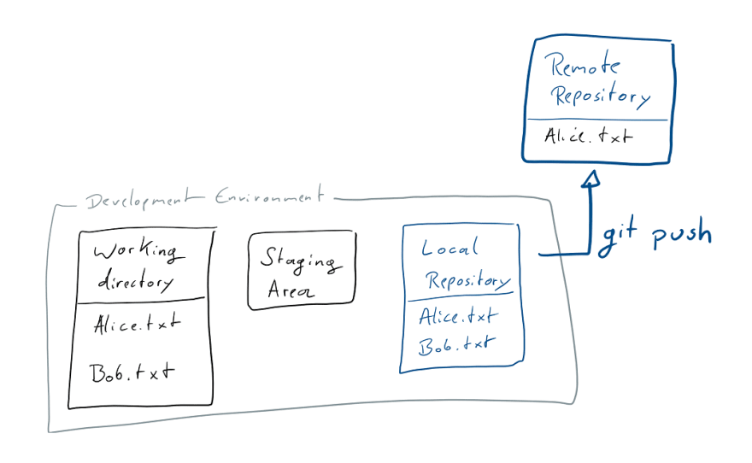
Add new files - Push
Working Directory: tracked files that git knows about and untracked files
git status git add Bob.txt
git commit git commit -m "Add Bob"
git push

Slide 8
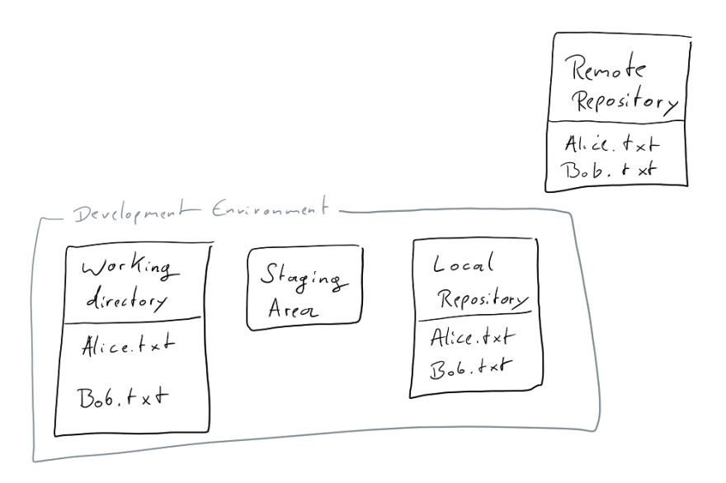
Add new files - After Git Push
Working Directory: tracked files that git knows about and untracked files
git status git add Bob.txt
git commit git commit -m "Add Bob"
git push

Slide 9
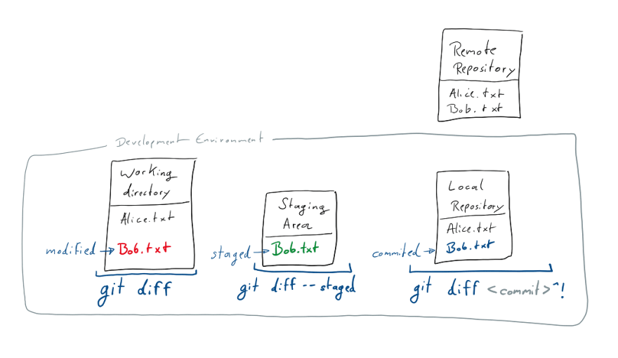
Making Changes
make change
git diff
git add
git diff --staged
git commit -m "Add text to Bob"
comparing commits:
git log
git diff <commit>^!

Slide 10
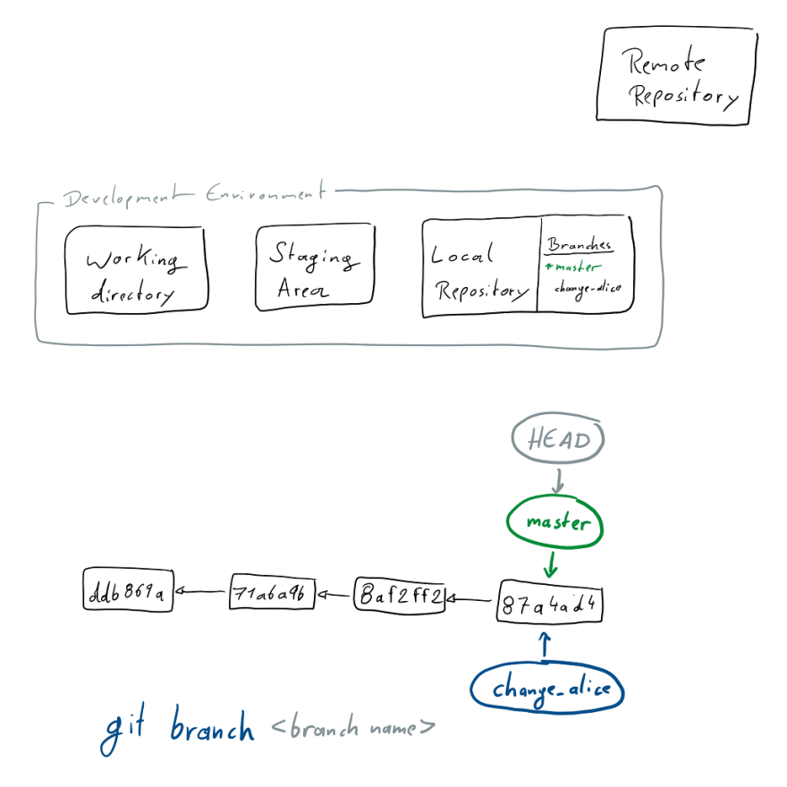
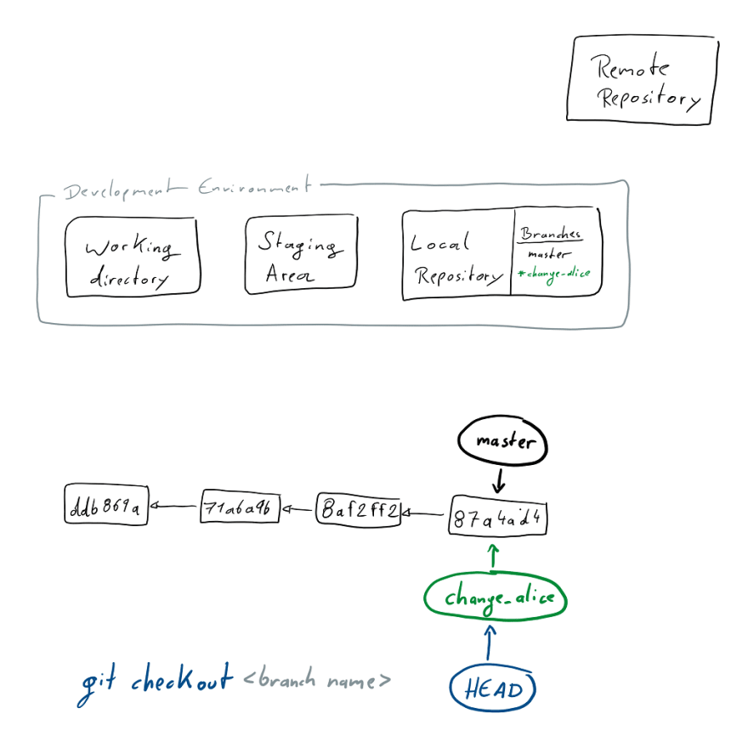
Branching
git branch <branch name>
git checkout change_alice [git checkout -b change_alice]

Slide 11
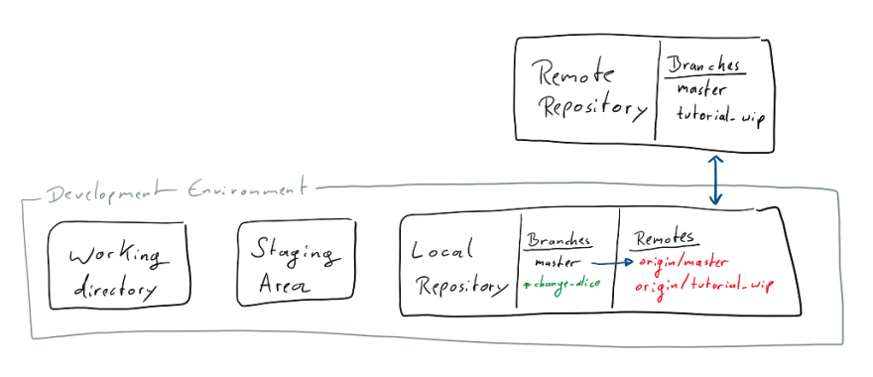
Branching - Remotes
Try to git push
What’s remote origin and upstream branches
git push --set-upstream origin change_alice, and push
git branch --set-upstream-to=origin/change_alice

Slide 12
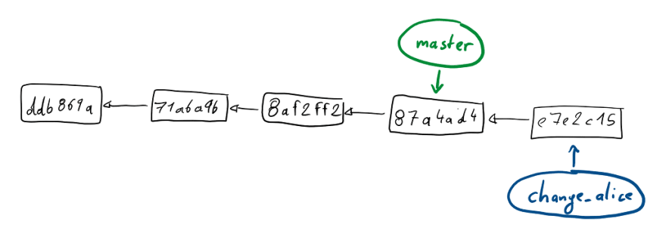
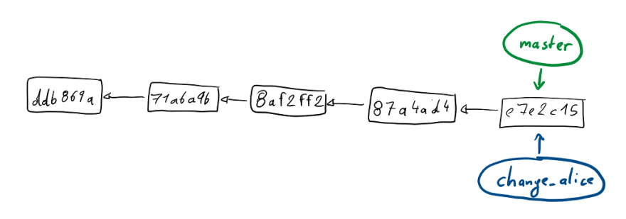
Merging
Fast forward merge:
change branch to master
git checkout master
git merge change_alice

Slide 13
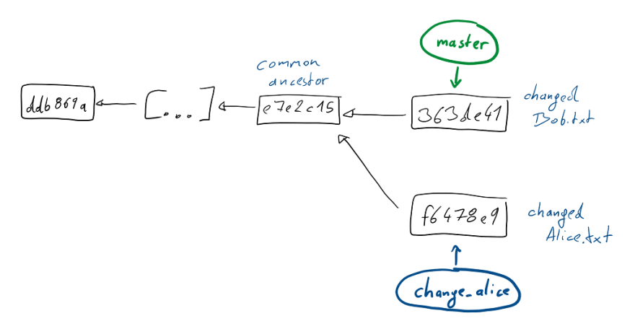
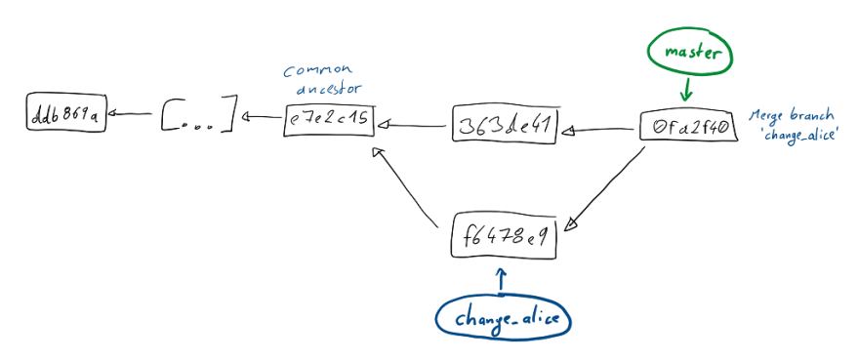
Merging
Merging divergent branches
Add some text on a new line to Bob.txt on master and commit it.
Then git checkout change_alice, change Alice.txt and commit.

Slide 14
Merging – Resolving Conflicts
Resolving Conflicts
git checkout -b bobby_branch
Bob.txt - change
checkout master
change same line

Slide 15
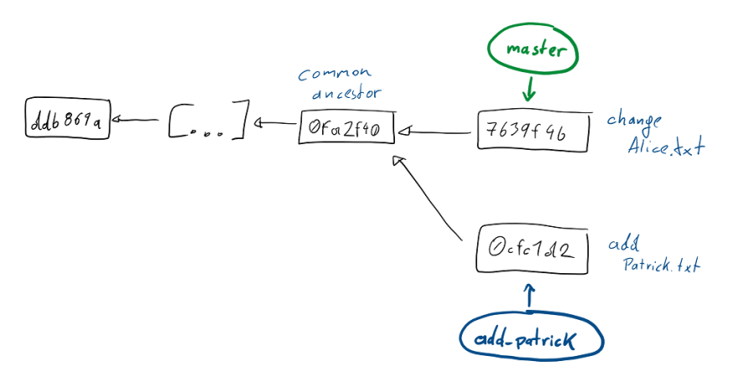
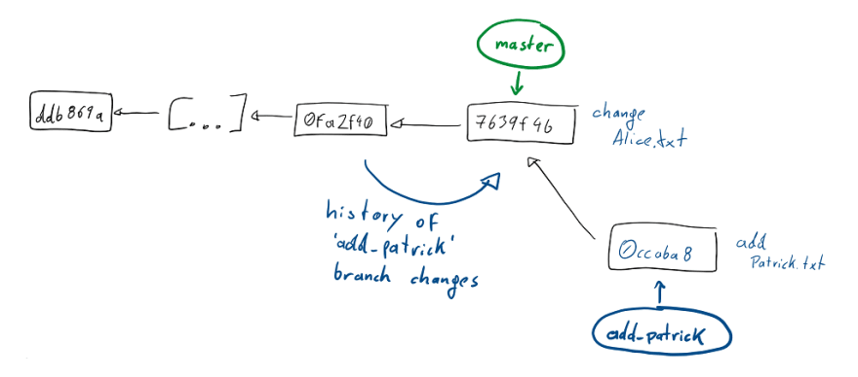
REBASE
Rebasing & Resolving conflicts
Cleaner way
git log --graph

Slide 16
To snack on later
git fetch
git pull
git stash
git pull –r
Cherry-picking

Slide 17
Thank you
Questions and Clarifications?

Slide 18

Thank You
Reference used:
https://dev.to/unseenwizzard/learn-git-concepts-not-commands-4gjc

